Slide 1
Deep Learning Training
Lecture 1: Deep Learning Introduction

Slide 2
Content
Deep Learning Application
AI, Machine Learning, Deep Learning
Why Deep Learning
Terminology
Model Evaluation

Slide 3
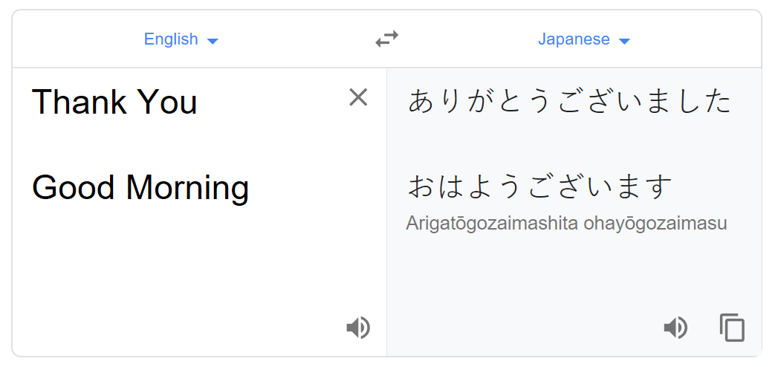
DL in Practice: Machine Translation
Machine Translate

Slide 4
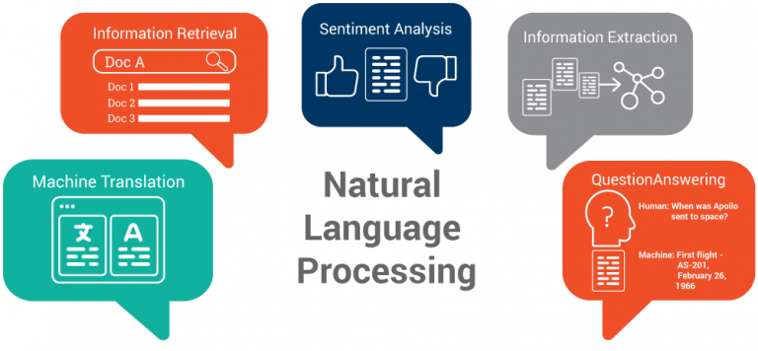
DL in Practice: Natural Language Processing
Natural Language Processing

Slide 5
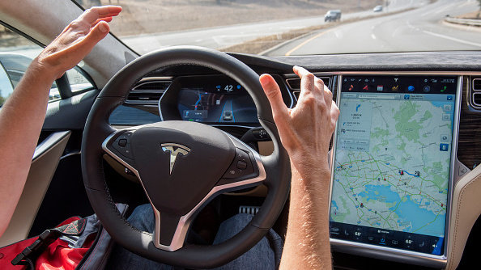
DL in Practice: Self Driving Car
Self Driving Car

Slide 6
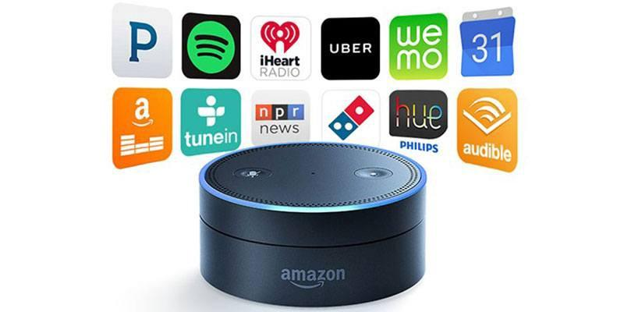
DL in Practice: Voice search and voice activated assistant
Alexa

Slide 7

DL in Practice: Face Recognition
Facebook Facial Recognition System

Slide 8
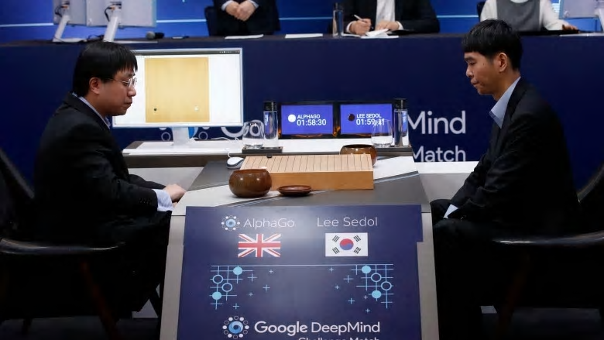
DL in Practice: Learning to Play Go
AlphaGo

Slide 9
Artificial Intelligence, Machine Learning & Deep Learning
Artificial Intelligence: The theory and development of computer systems able to perform tasks normally requiring human intelligence, such as visual perception, speech recognition, decision-making, and translation between languages.
Machine Learning: Machine Learning is a field of study that gives computers the ability to learn without being explicitly programmed.
Deep Learning: Class of machine learning algorithms that use multiple layers to progressively extract higher level features from raw input.

Slide 10
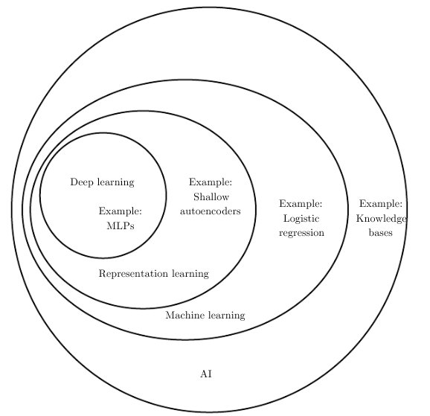
AI vs ML vs DL

Slide 11
Why Deep Learning
Representation Learning
Hierarchical Representation
No need of domain expertise
Increasing amount of data
Computational Power

Slide 12
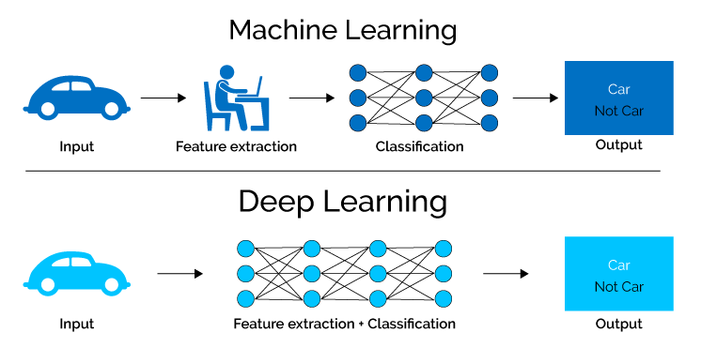
Representation Learning

Slide 13
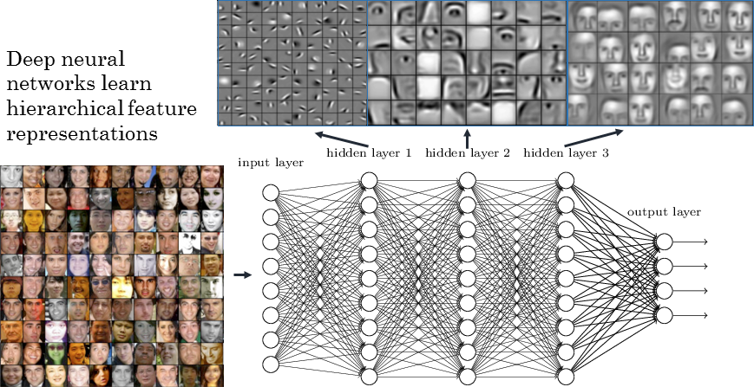
Hierarchical Feature Representation
Hierarchical representaion

Slide 14
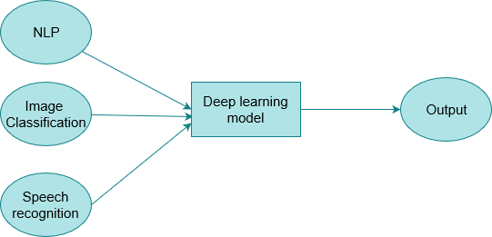
No need of Domain expertise
End to end learning
Same building blocks for different tasks

Slide 15
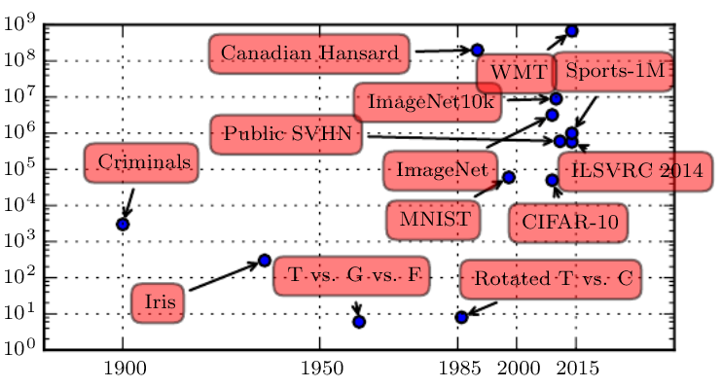
Increasing amount of data
Dataset Size (number of examples)
Time

Slide 16
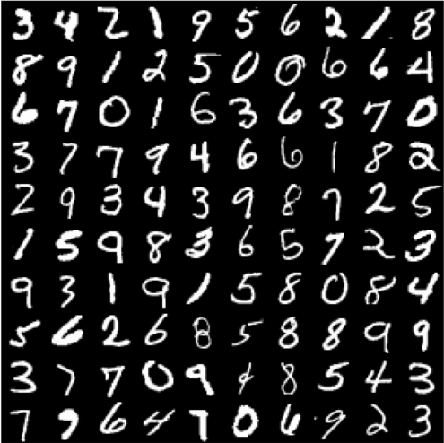
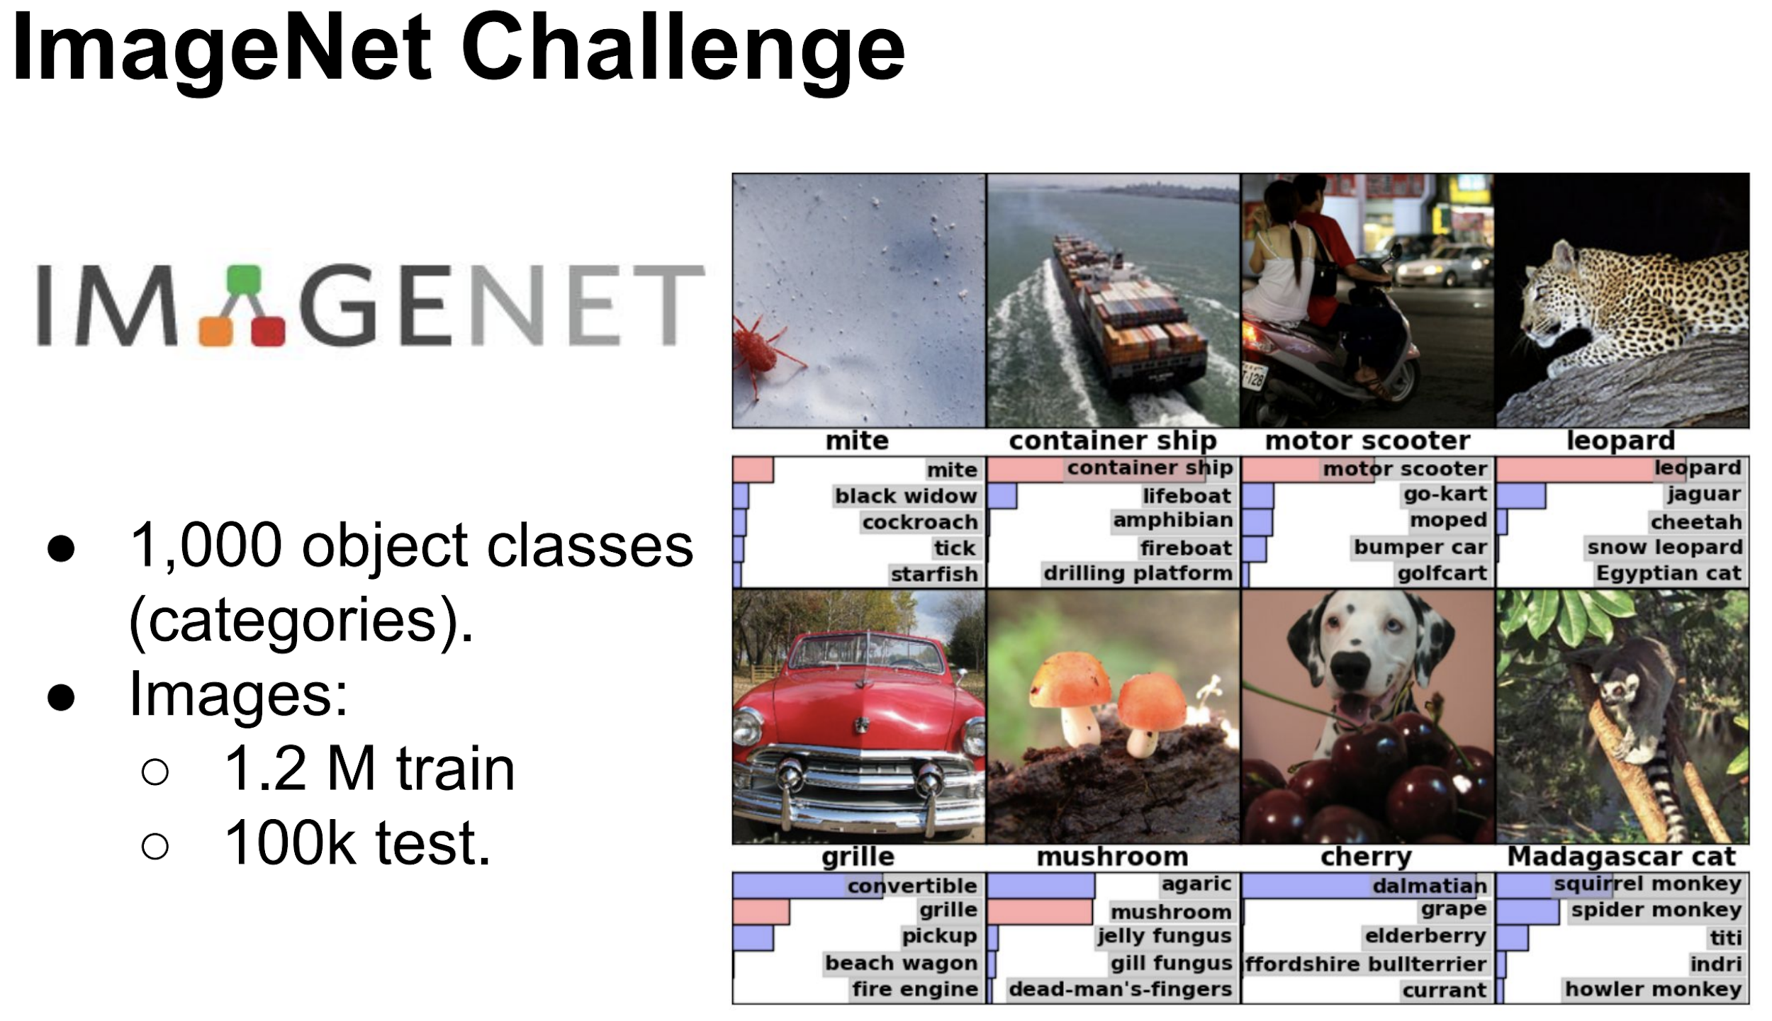
Increasing amount of data
MNIST
IMAGENT

Slide 17
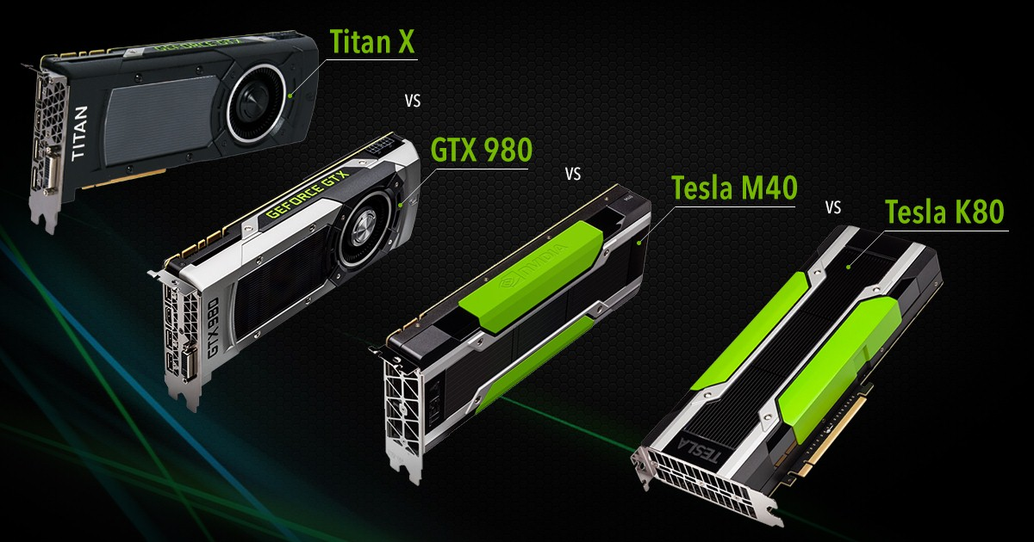
Increased Computational Power
Deep learning models are implemented with highly optimized matrix multiplication routines
GPU are inherently much better at performing matrix multiplication parallelly
GPU

Slide 18
Terminology
Example: An instance of data
Labeled: The correct output of data is given (Digits image and their value)
Unlabeled: Correct output not provided (News article without category)
Dataset: Collection of examples
Feature: Input variable used for training, after data has been processed for training
Spam detector: texts, sender email, time, word repetition etc.
Image classification: Raw image pixel
Model: Representation of what an ML system has learned from training data. Two phases
Training: Learning the model
Inference: Apply the model on unseen data

Slide 19
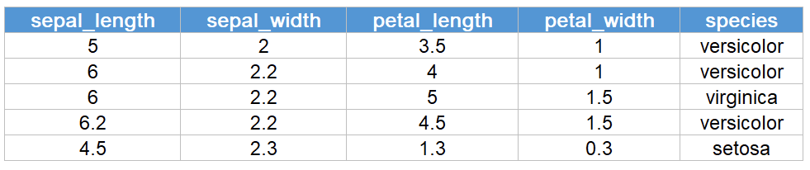
Dataset and Label
Features
Labels
Examples

Slide 20
Training, Validation and Test Set
Training set: Subset of data used for training the model
Validation set: Subset of dataset-disjoint from the training set used for validating model performance
Model is fine-tuned using validation set
Provides better generalization than using just train and test set
Test set: Subset of dataset that is used to test the model after it has been validated
No fine tuning should be done using test set
Ideally data should be from different source

Slide 21
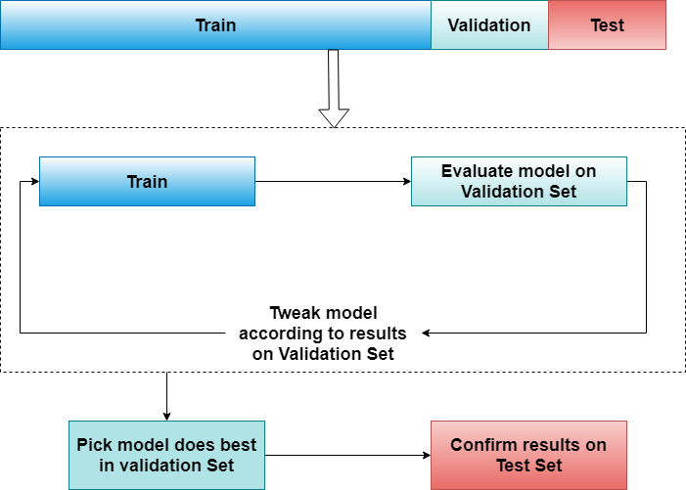
Training, Validation and Test Set

Slide 22
ML model types
Regression vs Classification:
Regression model predicts continuous values (house price, object location)
Classification model predicts discrete values (object category, spam or non-spam)
Supervised vs Unsupervised Learning:
Supervised: Labelled data provided for training (Learn to classify digits from labels)
Unsupervised: No labelled data provided (Cluster customers based on buying habits)

Slide 23
Model Evaluation metrics
Accuracy
Precision and Recall
F1 Score
Confusion Matrix
ROC and AUC curve
Cross validation

Slide 24
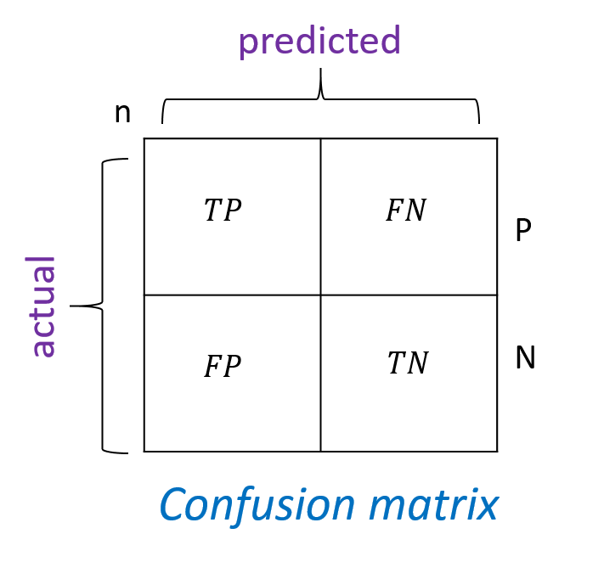
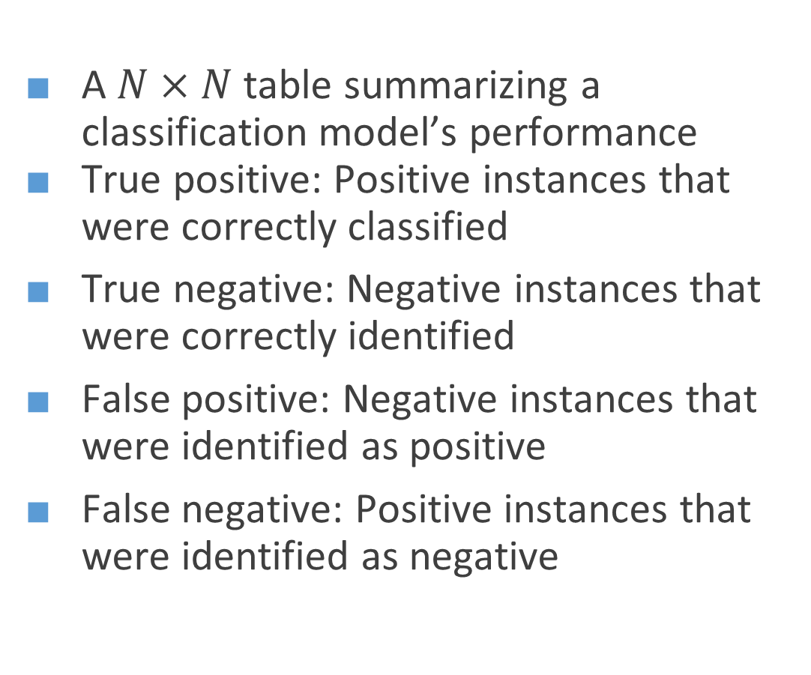
Confusion Matrix
A $N×N$ table summarizing a classification model’s performance
True positive: Positive instances that were correctly classified
True negative: Negative instances that were correctly identified
False positive: Negative instances that were identified as positive
False negative: Positive instances that were identified as negative

Slide 25
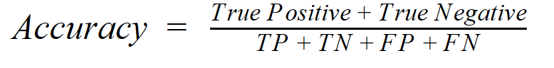
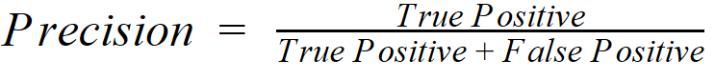
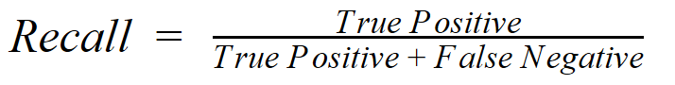
Evaluation metric

Slide 26
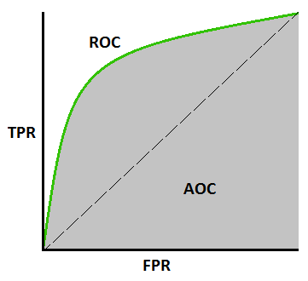
ROC and AUC
ROC(Receiver operating characteristic) curve: Plot of true positive rate vs false positive rate as different classification thresholds
AUC: Area under ROC curve, higher is better
Fig : ROC AUC curve

Slide 27
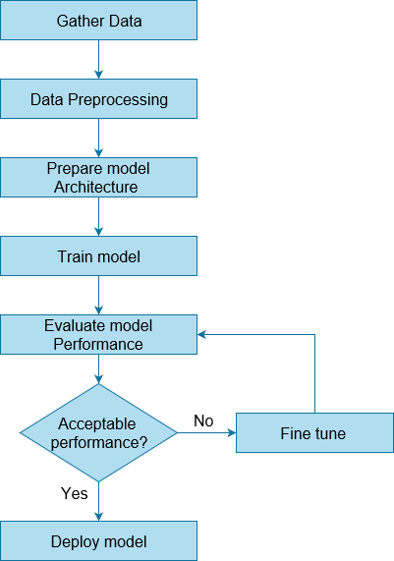
Workflow of a Deep Learning model

Slide 28
Tasks
Prepare some example tasks which cannot be done without machine learning with reasonable resource?

Slide 29
Thank You

